Slide 1



Ministry of Finance
Azerbaijan Republic
Introduction of Financial and Accounting Reporting Application for Budgetary Institutions
SERP
SINAM Enterprise Resource System
19.01.2017

Slide 2



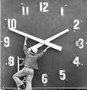


System history
1998 – System design
2003 – SERP put into exploitation
2004 – SERP receives copyright certificate
2006 – 2nd version
2007 – 3rd version
2008 – SERP 4.0
2010 – SERP 5.0 Cloud version

Slide 3
Introduction
Objective:
Objective of the project is establishment of unified centralized IT system for budget institutions, based on the modern accounting and reporting standards.
What is SERP?
SERP is an enterprise resource system aimed to automate back office functions in budget institutions. The software integrates all facets of financial and administrative operations, including recording of daily accounting transactions, payroll, maintenance of records on fixed assets and inventory, employee life-cycle, and automatic generation of reports required by the Ministry of Finance.
The system is developed within the framework of the Corporate and Public Sector Accountability Project (Ministry of Finance / The World Bank)

Slide 4
Advantages of SERP
Compliance of procedures and reports to Azerbaijan legislation
Integration with the systems of the Ministry of Taxes, SSPF and TIMS (Treasury Information Management System)
Integration with other IT systems is possible
Universal and convenient user interface
Multilingual interface - “3 +”
Multifunctional customization
Export of charts and reports to MS Office applications
Video lessons for trainings
Universal search system
Comprehensive and flexible reporting options

Slide 5
Implementation of the system
Implementation of the system in budget institutions is carried out in three phases:
Phase 1 – Introduction of the system in 39 institutions, including HQ of 9 ministries
  Total list of enterprise and organizations where the project is implemented - 39
  including:
  Universities financed from state budget - 18
  Commercial universities - 1
  Other budget institutions - 20
Phase I
Phase 2 – Introduction of the system in additional 60 institutions.
  Total list of enterprise and organizations where the project is implemented - 60
  including :
  Universities financed from state budget - 6
  Other budget institutions - 54
Phase II
Phase 3 – Introduction of the system in all budget institutions across the country.
The Phases 1, 2 are implemented within the framework of CAPSAP project.

Slide 6
System sustainability
A Certified Service Center for SERP system will be established to carry out system maintenance and support, enroll new users, deliver trainings to staff of user institutions, etc.
The 3rd Phase will be implemented by the Ministry of Finance through the Service Center .

Slide 7





Organizations that use the System
Number of organizations already connected into the System:
111 Budget institutions:
  30 Education and Science institutions
  7 Courts
  74 other State Authorities (Ministries, Committees, State Services, etc.)
  3 private organizations
  1 affiliation of foreign university
  Number of organizations to be connected into the system in 2016-2017:
  155 Budget institutions:
    44 Education and Science institutions
    111 other State Authorities

Slide 8
Phase 1
The system in introduced in 39 institutions:
Azerbaijan Technical University State Management Academy under the President of the Republic of Azerbaijan Khazar University Baku State University Azerbaijan Medical University Azerbaijan State Oil Academy Azerbaijan Architecture and Construction University Azerbaijan State Pedagogical University Baku Music Academy Azerbaijan National Conservatory Baku Slavic University Azerbaijan State Economic University Azerbaijan Teachers Institute Azerbaijan Tourism Institute Azerbaijan State Culture and Art University Azerbaijan State Academy of Physical Culture and Sport Ganja State University Mingachevir Polytechnic Institute Azerbaijan Languages University Central Apparatus of Ministry of Finance of the Republic of Azerbaijan Azerbaijan Amelioration and Water Management OJSC Public Debt Management Agency of Ministry of Finance of the Republic of Azerbaijan State İnsurance Control Service Finance department on Masalli region | Central Apparatus of Ministry of Culture and Tourism of the Republic of Azerbaijan Central Apparatus of Ministry of Youth and Sport of the Republic of Azerbaijan Central Apparatus of Ministry of Health of the Republic of Azerbaijan Central Apparatus of Ministry of Education of the Republic of Azerbaijan Central Apparatus of Ministry of Communication and High technologies of the Republic of Azerbaijan Central Apparatus of Ministry of Culture and Tourism of the Republic of Azerbaijan State Finance Control Service of Ministry of Finance of the Republic of Azerbaijan Head Finance office on Baku city Head Finance office on Sumgait city Head Finance office on Absheron region Central Apparatus of Ministry of Ecology and Natural Resources of the Republic of Azerbaijan State Committee of the Republic of Azerbaijan on deals of refugees and internally displaced persons The State Statistical Committee of the Republic of Azerbaijan State Committee on work with Diaspora of the Republic of Azerbaijan Central Apparatus of Ministry of Transport of the Republic of Azerbaijan Central Apparatus of Ministry of Energy of the Republic of Azerbaijan

Slide 9
Phase 2
The second phase envisages installation of the system in additional 60 sites:
Azerbaijan State Academy of Arts Sumgait State University Azerbaijan Technological University (Ganja) Azerbaijan State Agricultural University(Ganja) Lankaran State University The State Committee for Family, Women and Children affairs of the Republic of Azerbaijan The State Committee for Architecture and Urban Planning of the Republic of Azerbaijan IcheriSheher State Historical-Architectural Reserve Boulevard Office under the Cabinet of Ministers of the Republic of Azerbaijan Supreme Attestation Commission Under the President of the Republic of Azerbaijan State Agency on Procurement Standardization, Metrology and State Committee on Patend of the Republic of Azebaijan The Copyright Agency of the Republic of Azerbaijan National Archive Fund Civil Service Commission Under the President of the Republic of Azerbaijan State Agency On Alternative And Renewable Energy Sources Office of the State Flag Square Complex Chamber of Accounts of the Republic of Azerbaijan State Phytosanitary Control Service under the Ministry of Agriculture of the Republic of Azerbaijan State Service for Registration of Real Estate under the State Committee on property issues of Azerbaijan Republic | State Veterinary Control Service within the Ministry of Agriculture of The Republic of Azerbaijan State Service on Agricultural Projects and Credits Management under The Ministry of Agriculture of The Republic of Azerbaijan Tariff (price) Council of Azerbaijan Republic The Constitutional Court of the Republic of Azerbaijan Baku Court of Appeal The Azerbaijan State Telegraph Agency – (AZERTAC) National Television and Radio Council of the Republic of Azerbaijan Judicial-Legal Council of the Republic of Azerbaijan State Civil Aviation Administration of Azerbaijan Republic Heydar Aliyev Center National Library named after M.F. Akhundov The council on State Support to NGOs under the auspices of the president of the Republic of Azerbaijan Azerbaijani National Representative of “MİR” Interstate Tele radio company The Republic of Azerbaijan Ministry of Economy and İndustry National Fund for Entrepreneurship Support International Mugham Center Azerbaijan Red Crescent Society State Service for Antimonopoly Policy and Consumer Rights Protection Finance Science and Education Centre under the Ministry of Finance of the Republic of Azerbaijan | Ganja Court of Appeal Sheki Court of Appeal Baku Business Training Center of the Ministry of Economy and Industry of the Republic of Azerbaijan Ataturk Center in Azerbaijan Sumgait Court of Appeal Military, Labor Veteran Association of the Republic of Azerbaijan Ministry of Agriculture of the Republic of Azerbaijan State Social Protection Fund of the Republic of Azerbaijan The State Students Admission Commission of the Republic of Azerbaijan The State Committee on Property Issues of Azerbaijan Republic Ministry of Economy and Industry of the Republic of Azerbaijan Supreme Court of the Republic of Azerbaijan “Azerbaijan National Encyclopedia” science center The Fund of State Support for the Development of Mass Media of under the President of the Republic of Azerbaijan Public Television and Radio Broadcasting Company of the Republic of Azerbaijan Republic of Azerbaijan Agency for Rehabilitation and Reconstruction of Area Union of Azerbaijani Writers International Relations Center State Labor inspectorate service Azerbaijan National Agency for Mine Action Union Artists of Azerbaijan Shirvan Court of Appeal

Slide 10
Pilot institutions
Ministry of Education, HQ
Ministry of Health, HQ
Ministry of Culture and Tourism, HQ
Ministry of Youth and Sport, HQ
Ministry of Finance, HQ
Pilot Universities:
Baku State University
Azerbaijan Technical University
State Management Academy under President of Azerbaijan Republic
Khazar University

Slide 11
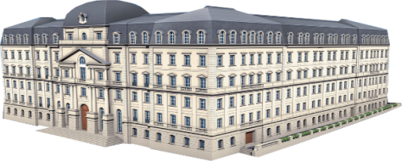







Architecture of SERP
Ministry of Taxes
Ministry of Finance
State Social Protection
Fund
FARABI
Budget Institution 1
User 1 record
User 2 record
…
User N record
Reports
Network of SSPS
Customs Committee
Committee on State
Property
Network of SSPS
State Oil Fund
Budget Institution 2
...
Network of SSPS
Central Bank
Payments and document exchange
Supplier 1
Budget Institution N
TIMS
Payments
Payments
Supplier 2
...
User 1 record
User 2 record
…
User N record
Single Treasury Account
of Government
Supplier N

Slide 12

SERP Architecture
Enterprise design
Personal cards
Timesheet
Payroll
Assignments
Recruitment
Performance management
“University” add-on
  Student registration
  Scholarship
  Tuition fee
General ledger
Inventory
Fixed assets
Purchase
Sales/Marketing
Contracts management
Production/Services
Admin panel
UI configuration
Language localization
Rights management
Notifications configuration
Media integration
Decision support
Data exchange
Task management Standard Reporting Business Intelligence
Integration with Tax Authority
Integration with Social Security system
Integration with Treasury

Slide 13
Work process of system implementation
Employees’ input to the system
Loading the requests and documents into the system
Creation of system users.
Adjusting their rights and authorities
Adjusting accountance models
Maintenance of implemented system
Receiving the total balance sheet
Establishment of enterprise structure
Checking the loaded information and system loaded by client specialists
Export of preliminary remainders
Adjusting the system

Slide 14
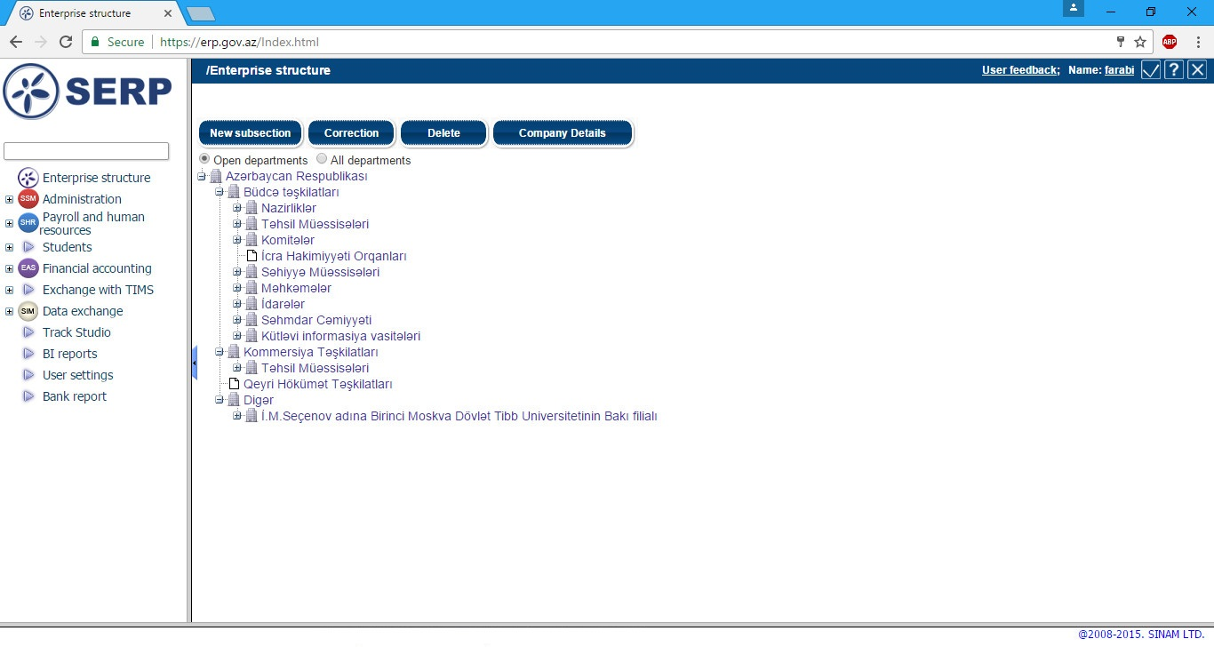
SERP: Organization structure
Hierarchical tree structure
Options to create organization, departments, sections (or university, faculty and departments)
Possibility to track structural changes
Making operations at the appropriate level of structure
Reporting corresponding to the appropriate level of structure

Slide 15
SERP: Personal files
Comprehensive information on the employee
Recording of the various details, ToRs and Operation instructions for teach position in the staff list
Time-sheet: Registration of standard business hours, recording of deviations
Recoding of annual leaves

Slide 16
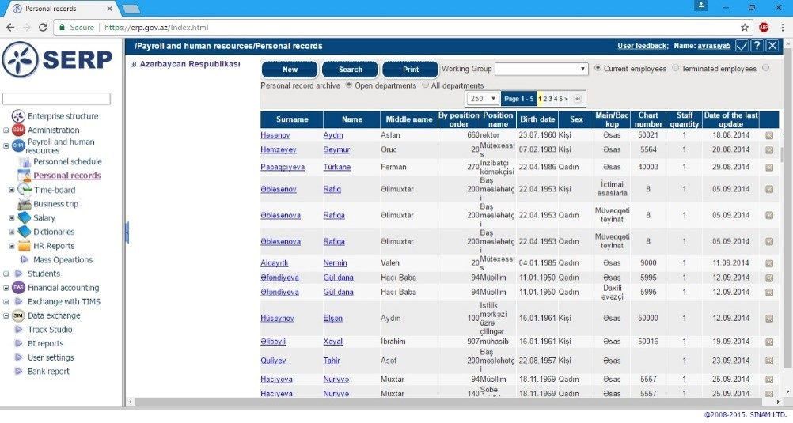
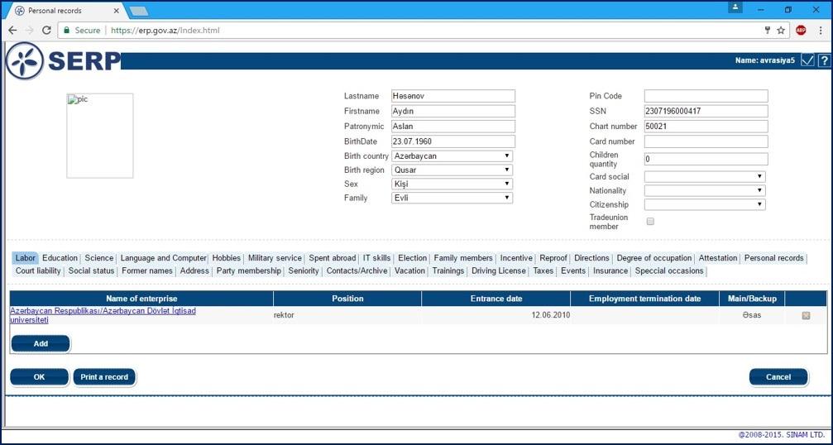
SERP: Personal files

Slide 17
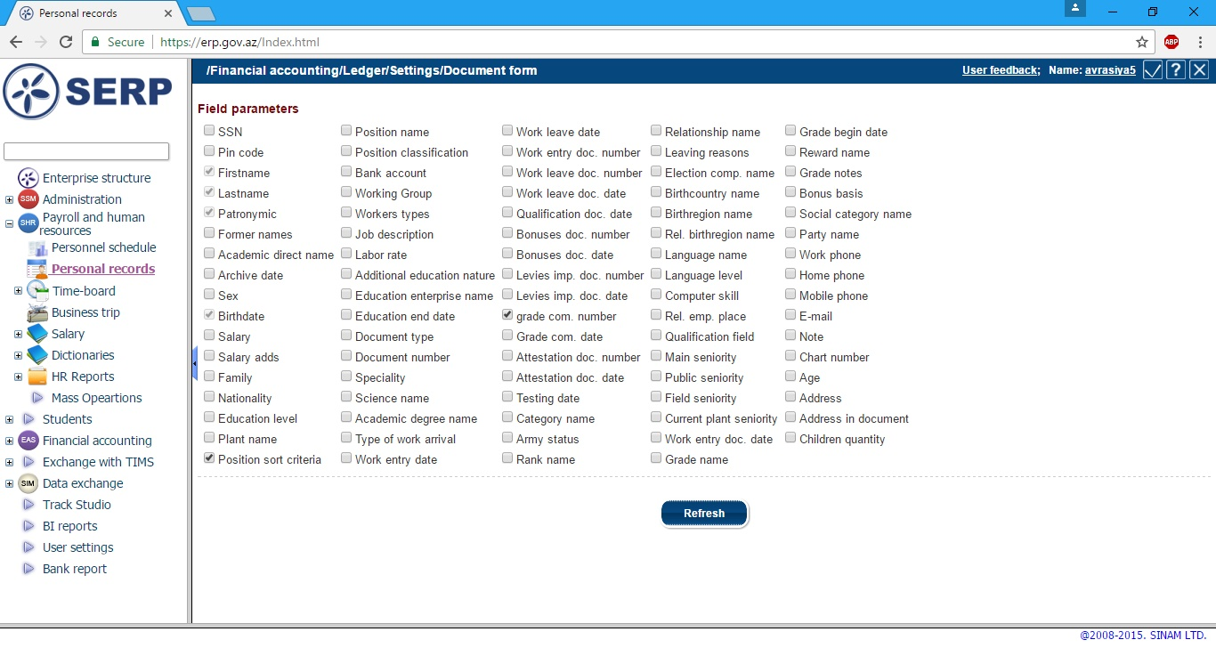
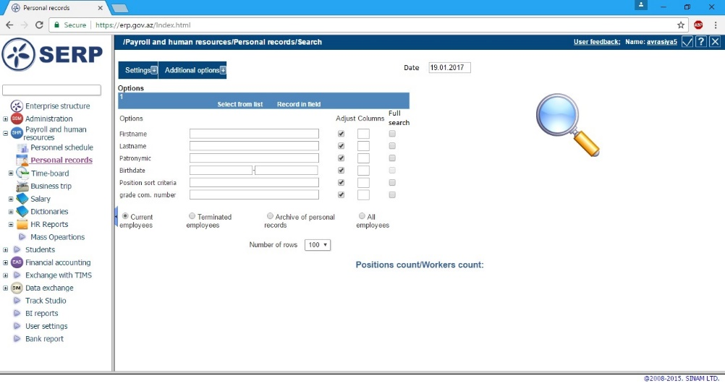
SERP: Search

Slide 18
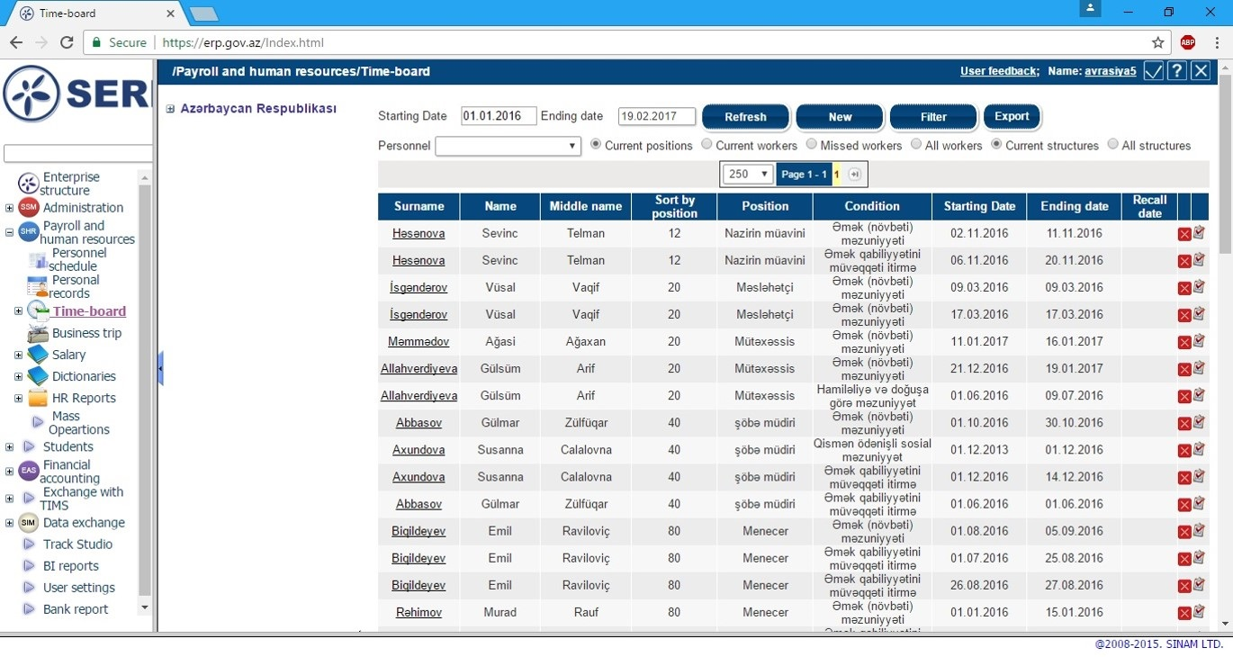
SERP: Time-board

Slide 19
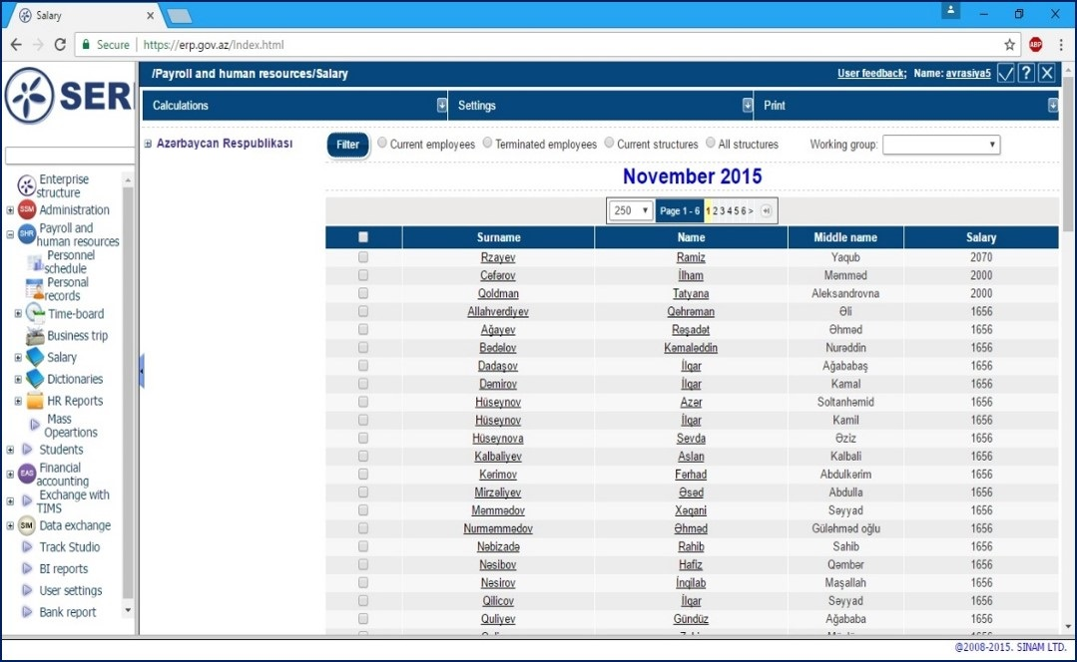
SERP: Salaries / payroll
Making all appropriate deductions from the salary (taxes and fees), as per legislation
Automated preparation of social security reports and bank documents
Control over safety of financial information
Generation of parameterized reports

Slide 20
SERP: Accounting methodology
Comprehensive and easy-adjustable charts of accounts
Creation and customization of accounting models
Making of accounting entries manually or based on created accounting models
Accounting in unlimited number of currencies
Standard initial document and reporting forms
Control over reporting period closure and balance

Slide 21
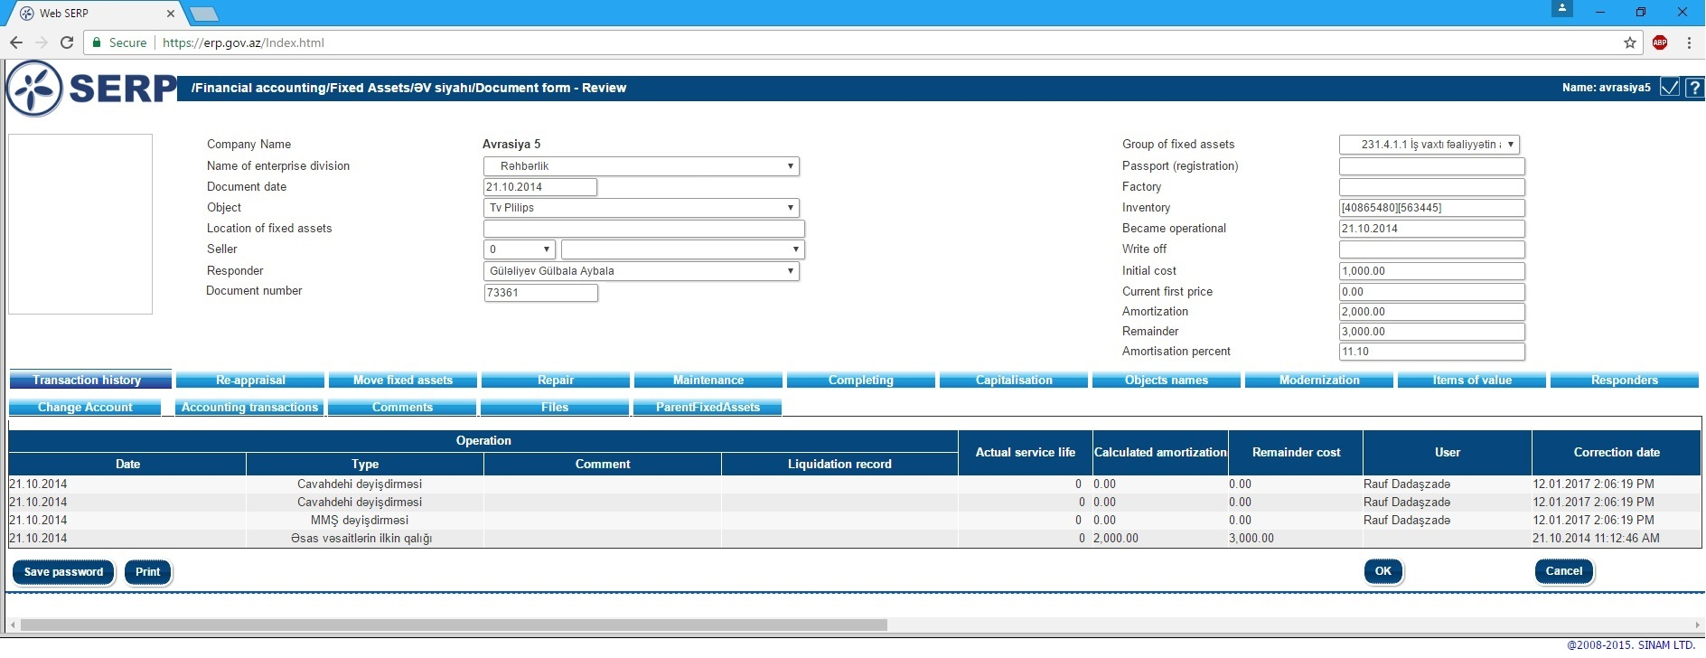
SERP: Fixed assets, inventory card

Slide 22
SERP: Fixed assets
Unique inventory number in a comprehensive inventory card
Responsible person
Amortization method
Other information
Recording of intangible assets
Civil works
Modernization
Revaluation
Registration of leasing and rent contracts and their recording in fixed assets
Financial and tax accounting of fixed assets

Slide 23
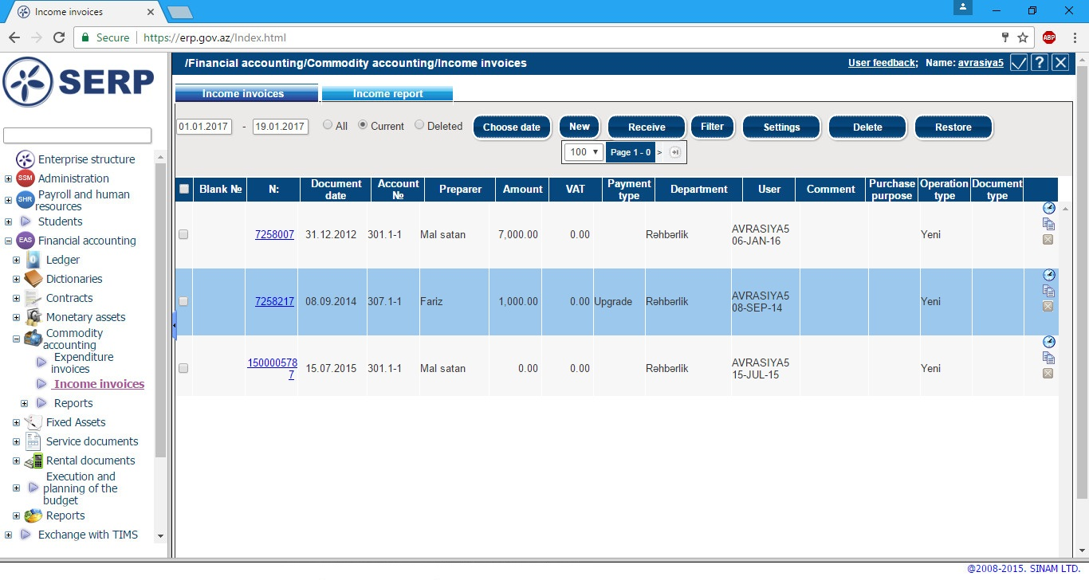
SERP: Warehouse and recording of services
Receipt and expenditure waybills, internal displacement documents, tax invoices, customs declarations
Recording of service orders and control over implementation

Slide 24
SERP: Treasury and bank operations
Recording of cash receipts and cash expenditures
Reconciliation of the receipt and expenditures with the contracts and payment schedules
Cash balance reports
Registration of unlimited numbers of bank accounts
Recording of bank transactions, payment orders, statements and other bank related documents

Slide 25
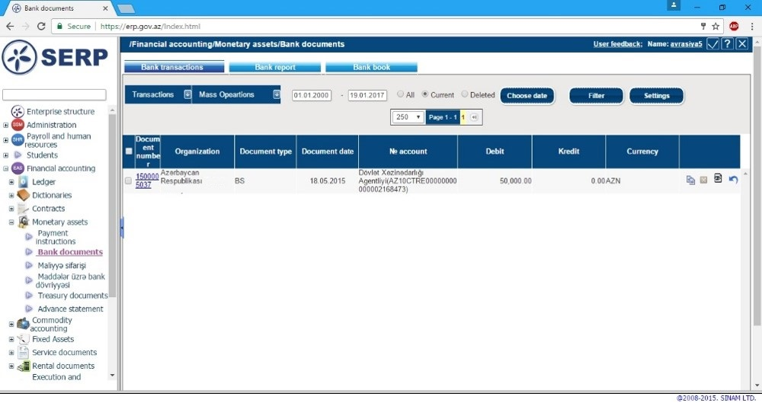
SERP: Bank operations

Slide 26
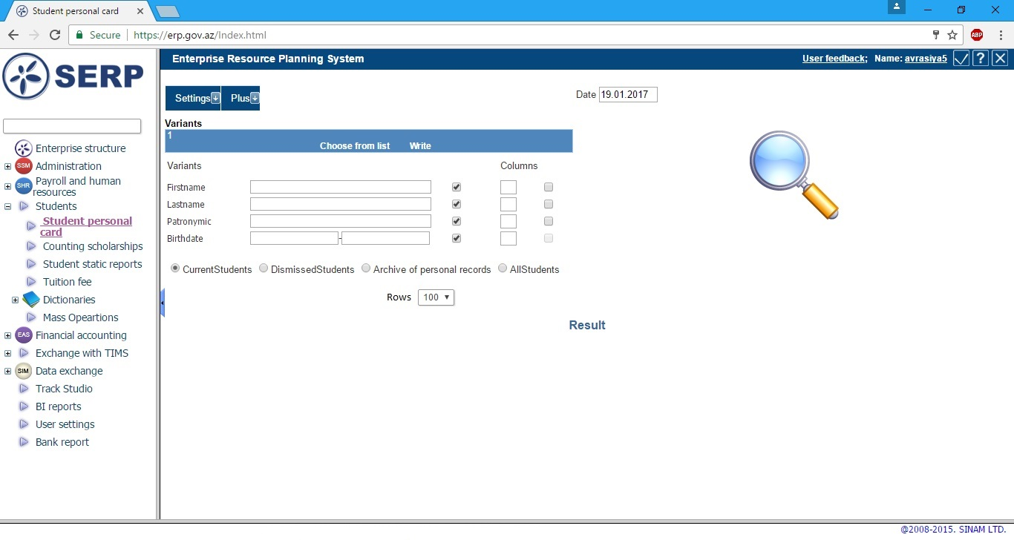
SERP – “Student”: Student Personal Card
- Search parameters

Slide 27
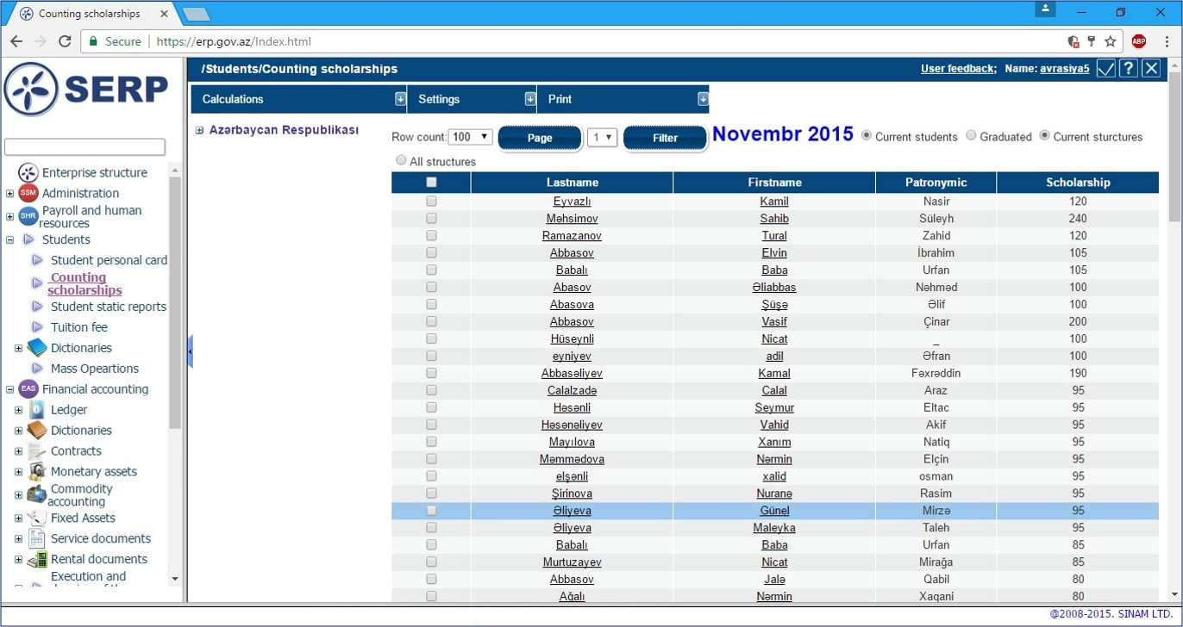
SERP – “Student”: Counting scholarships

Slide 28
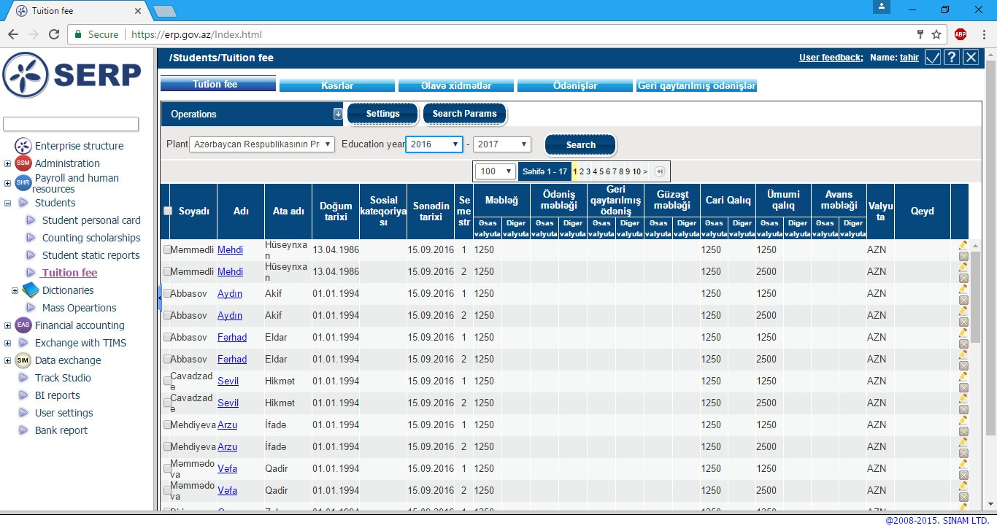
SERP – “Student”: Document on tuition fee

Slide 29
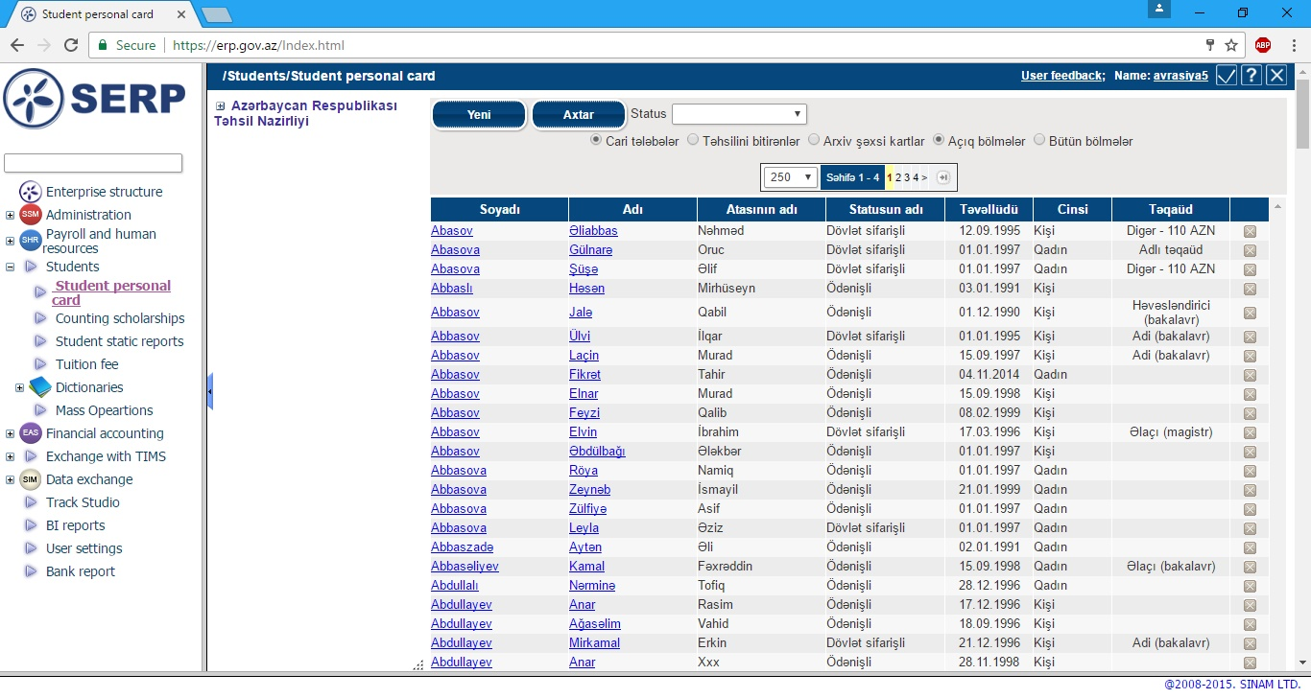
SERP – “Student”: Student Personal Card - List of students

Slide 30
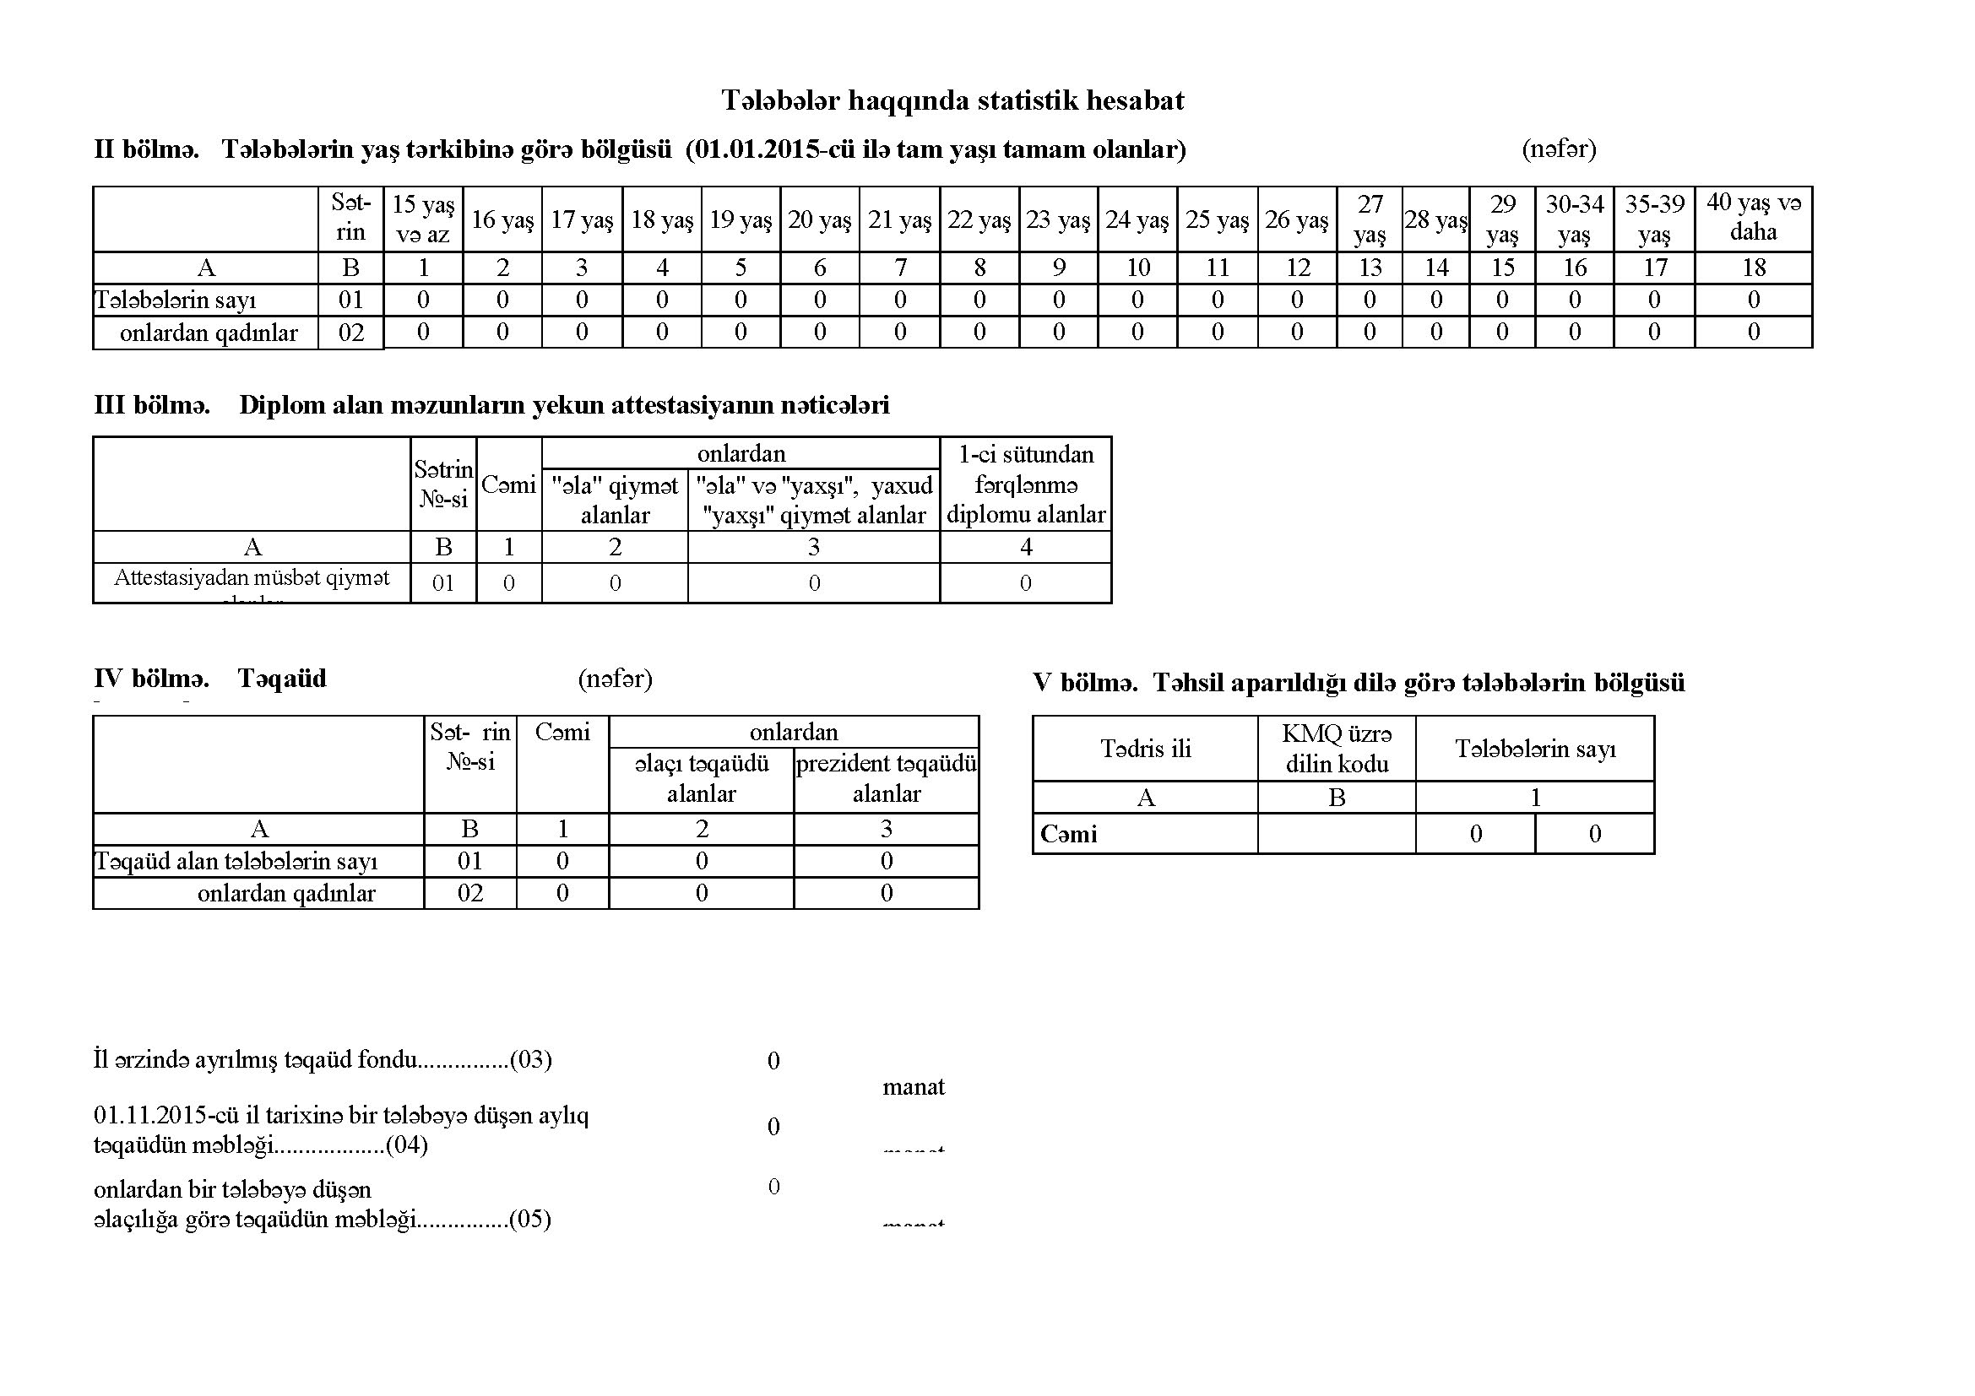
SERP – “Treasury”: Statistical report on students

Slide 31
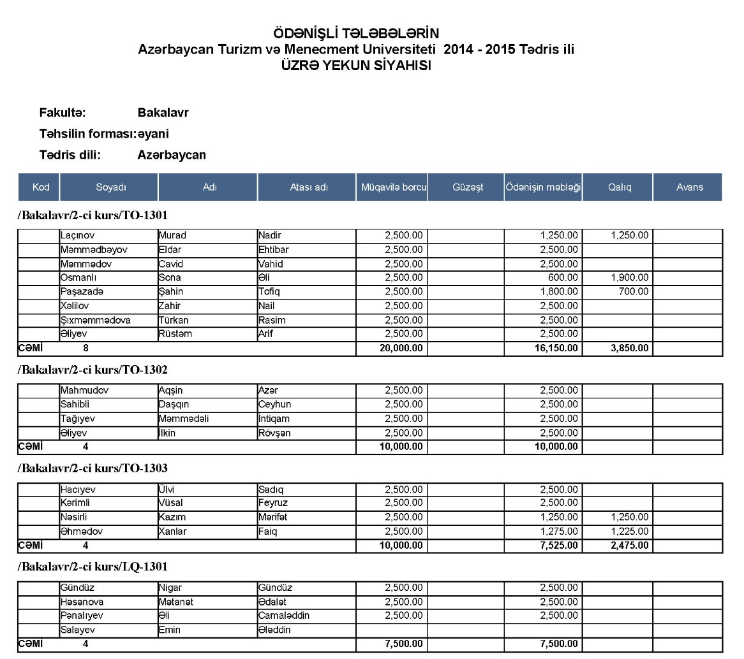
SERP – “Treasury”: Total list of paid students

Slide 32
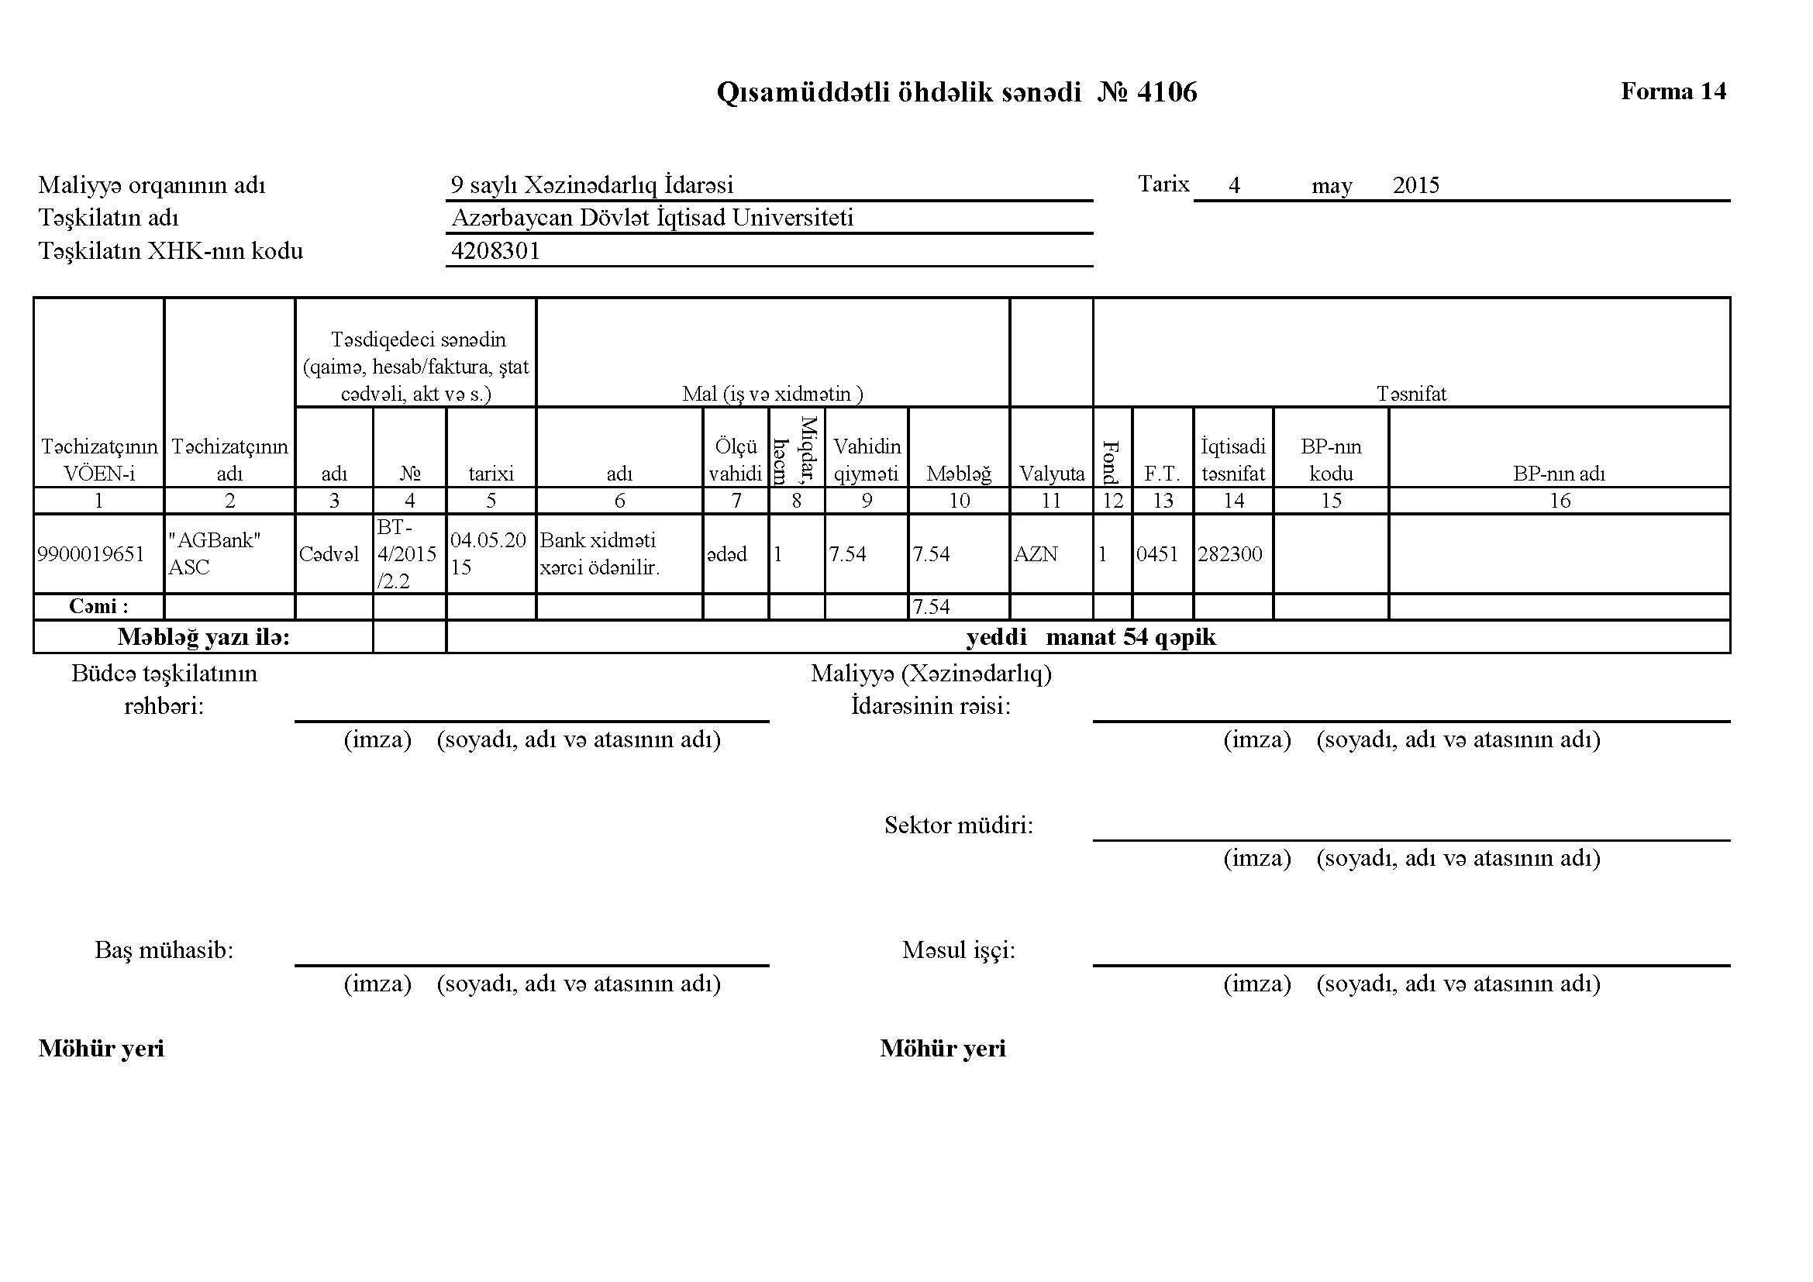
SERP – “Treasury”: Short-term liability document.

Slide 33
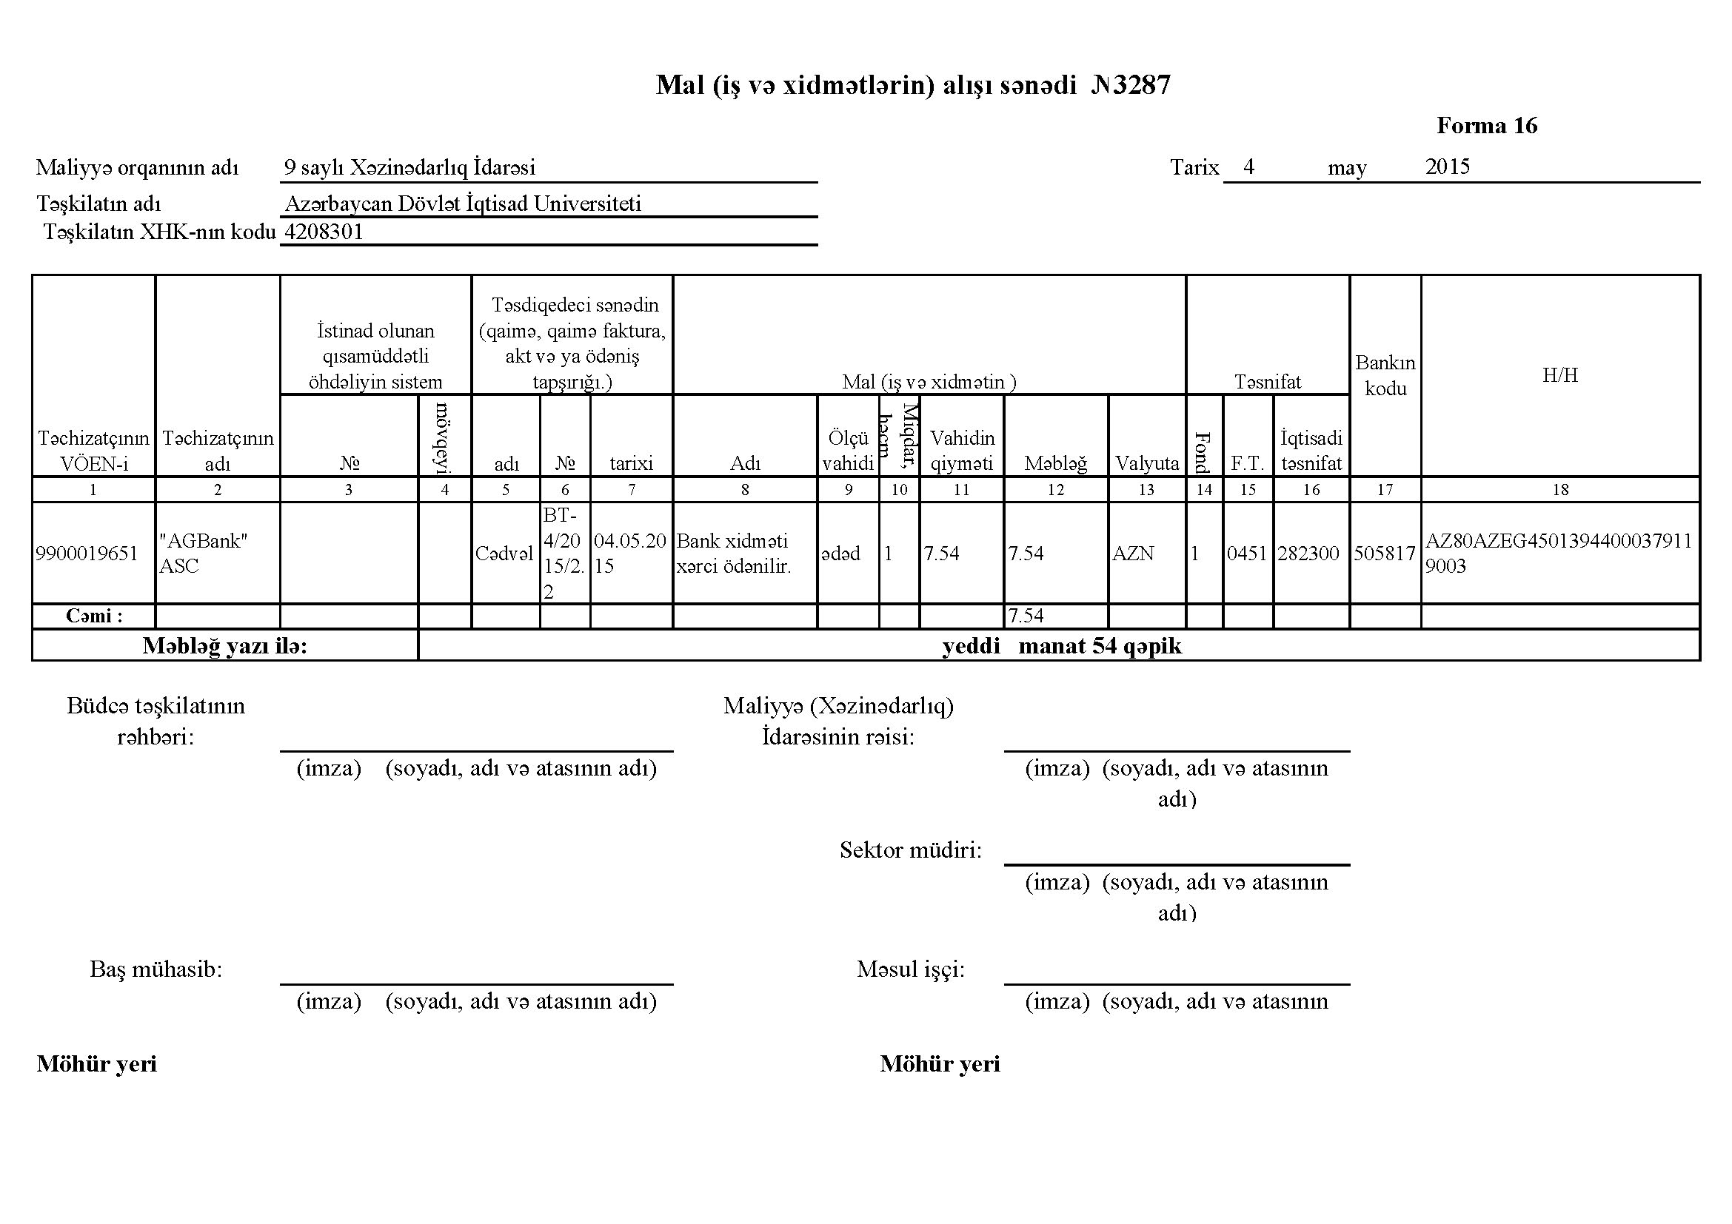
SERP – “Treasury”: Purchase document for goods (works, services).

Slide 34
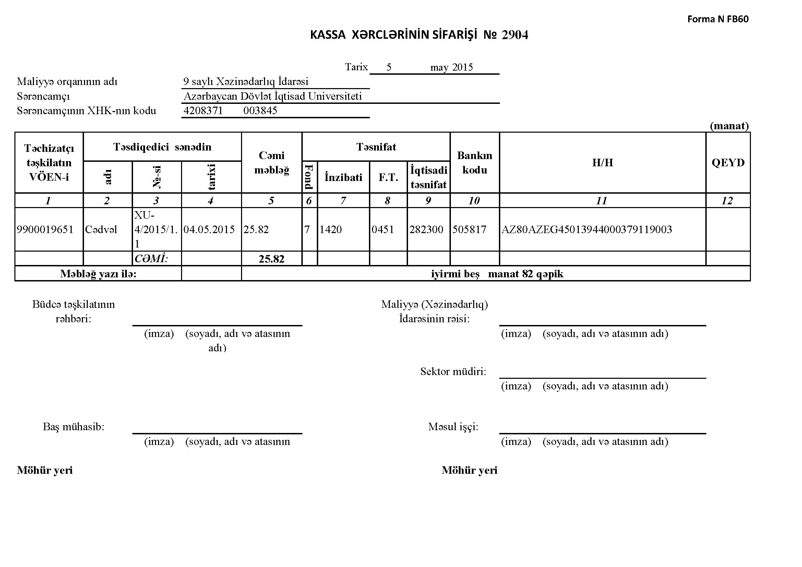
SERP – “Treasury”: Document for order of cash expenditures.

Slide 35
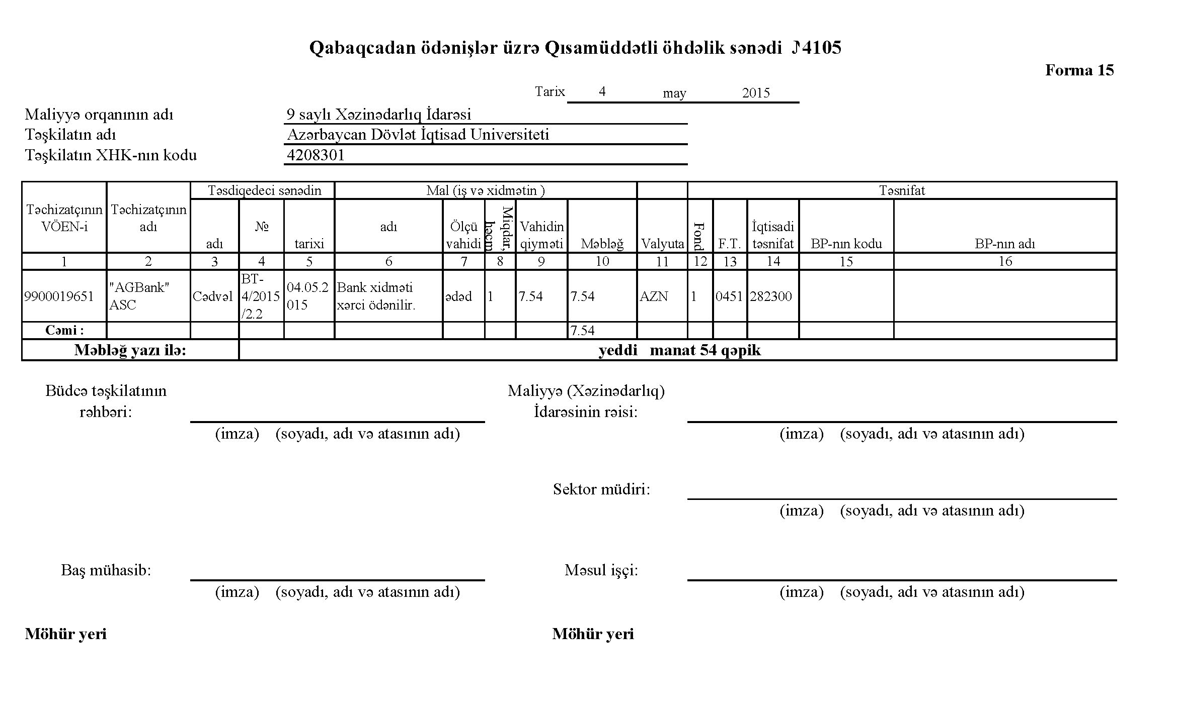
SERP – “Treasury”: Short-term liability document for advance payments.

Slide 36
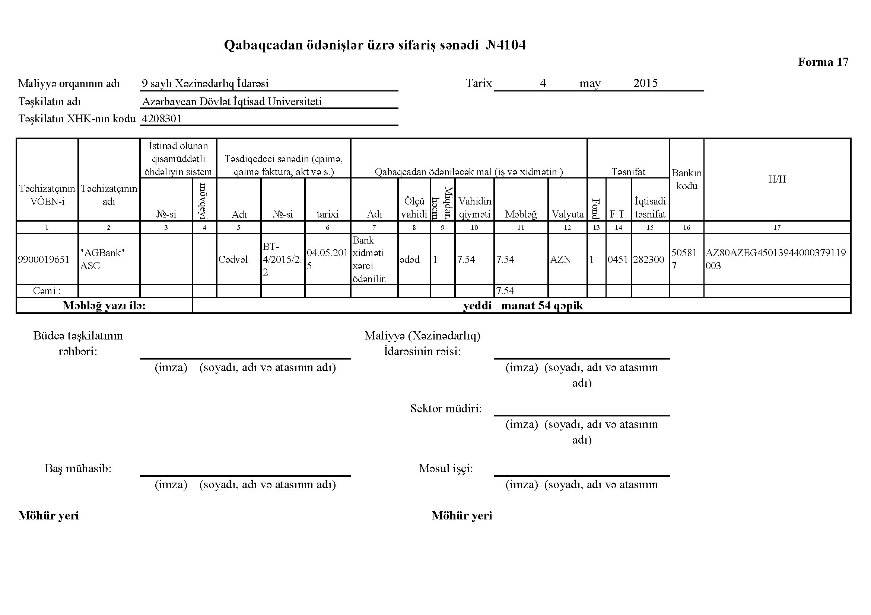
SERP – “Treasury”: Order for advance payment.

Slide 37
SERP: Security and e-signature
System allows creation of unlimited number of user profiles
It is possible to give various rights and authorities to different users or user groups
Audit system tracks user operations
All documents are signed by the e-signature issued by the Main Certification Centre (PKI infrastructure)
Sending of data over an encrypted SSL protocol

Slide 38
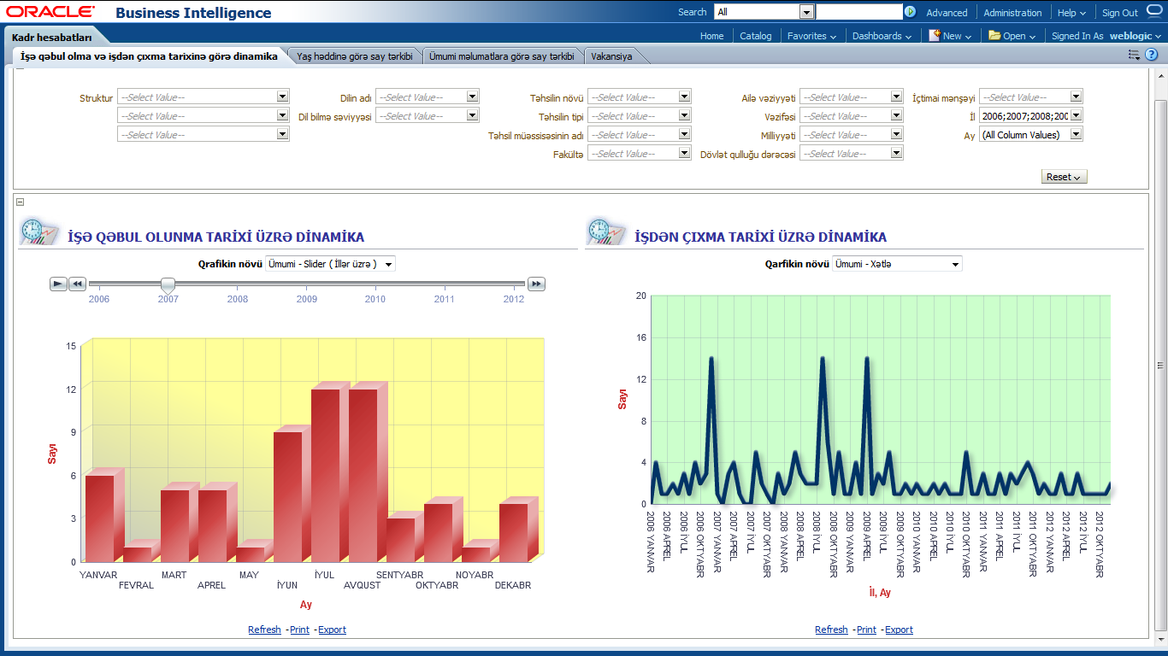
Reports generated by the system
Analytical reports in Oracle BI system
HR reports

Slide 39
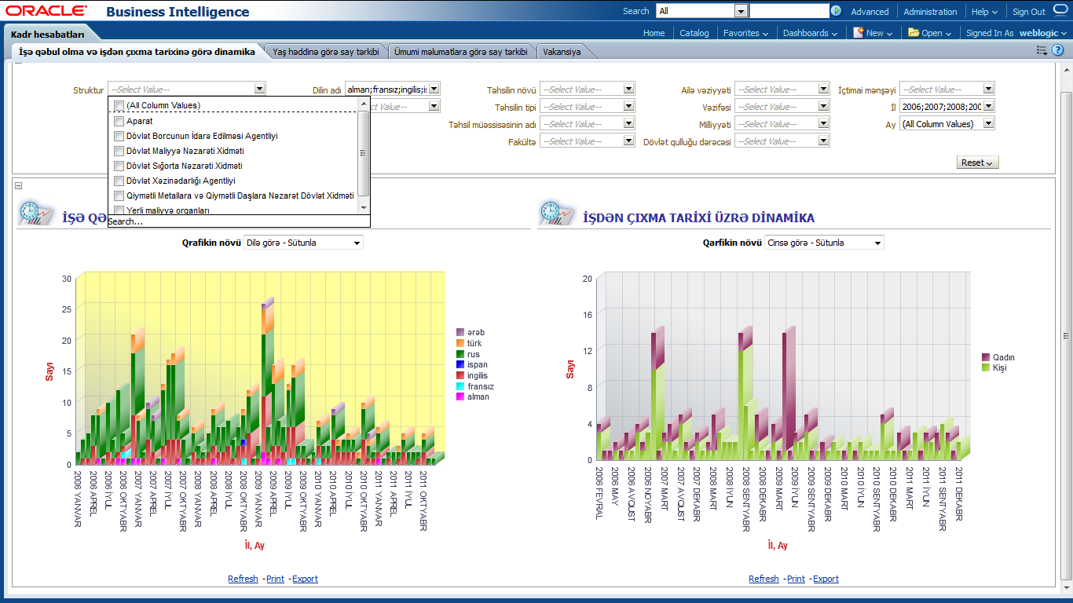
Reports generated by the system
Dynamics of number of hired and fired employees by dates

Slide 40
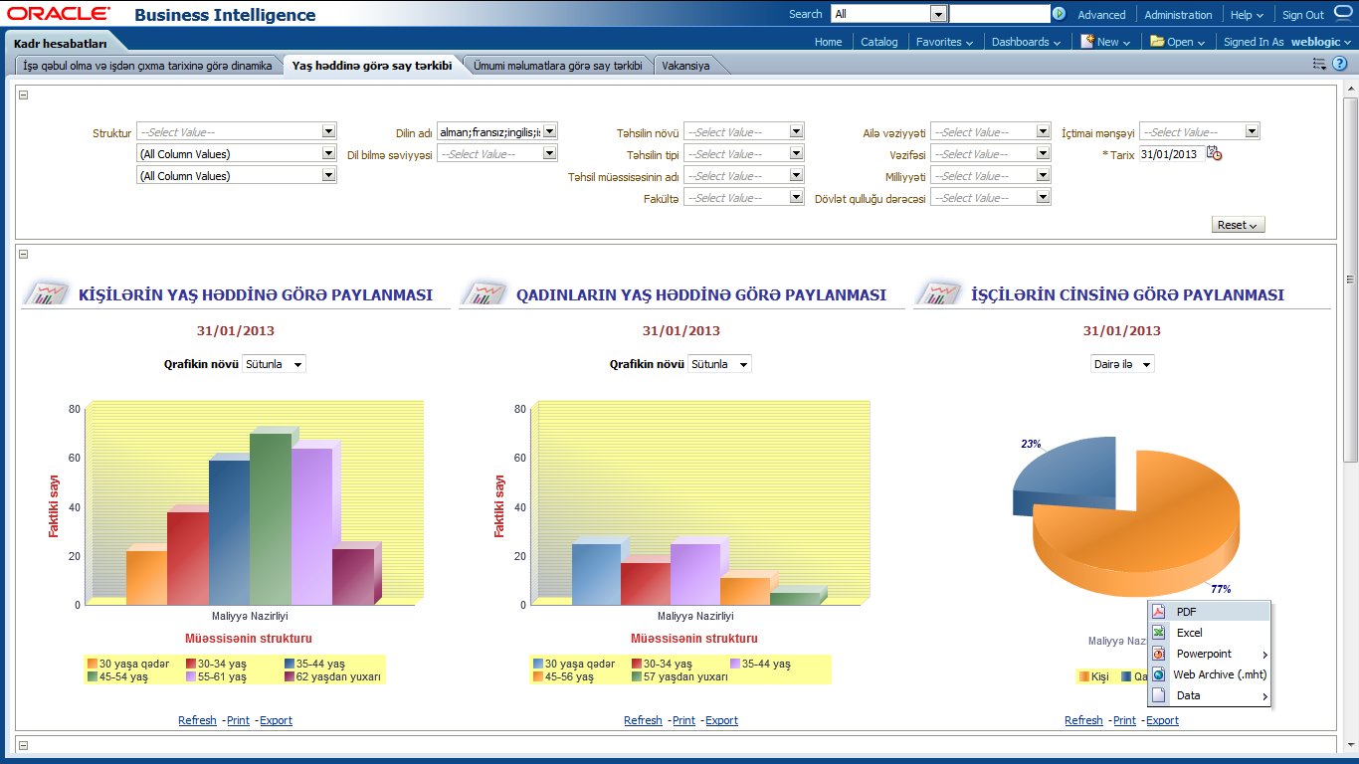
Reports generated by the system
The system supports export of visual models to Microsoft Powerpoint, Microsoft Excel, Adobe PDF formats

Slide 41
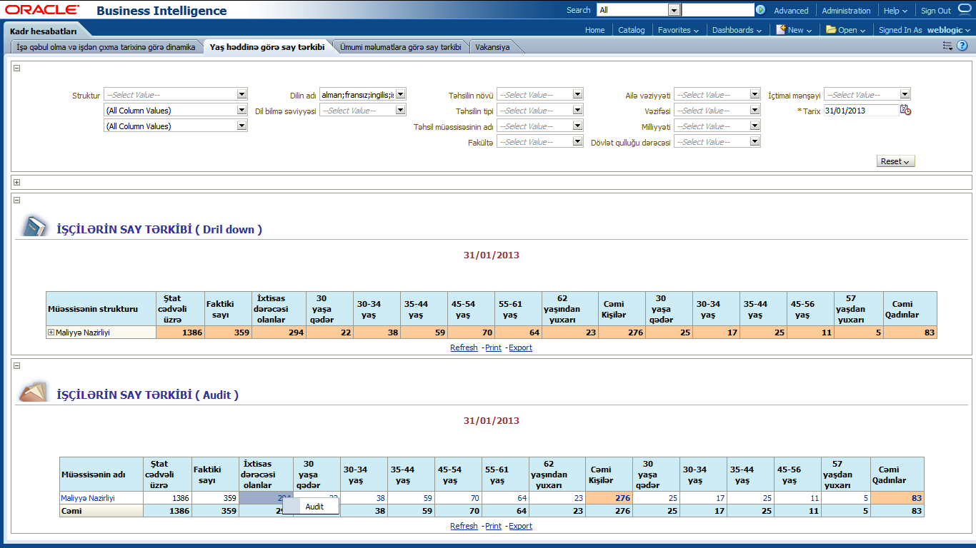
Reports generated by the system
The system supports drill-down and audit mechanisms, enabling the user to move from the more general view of the data to a more specific one at the click of a mouse.

Slide 42
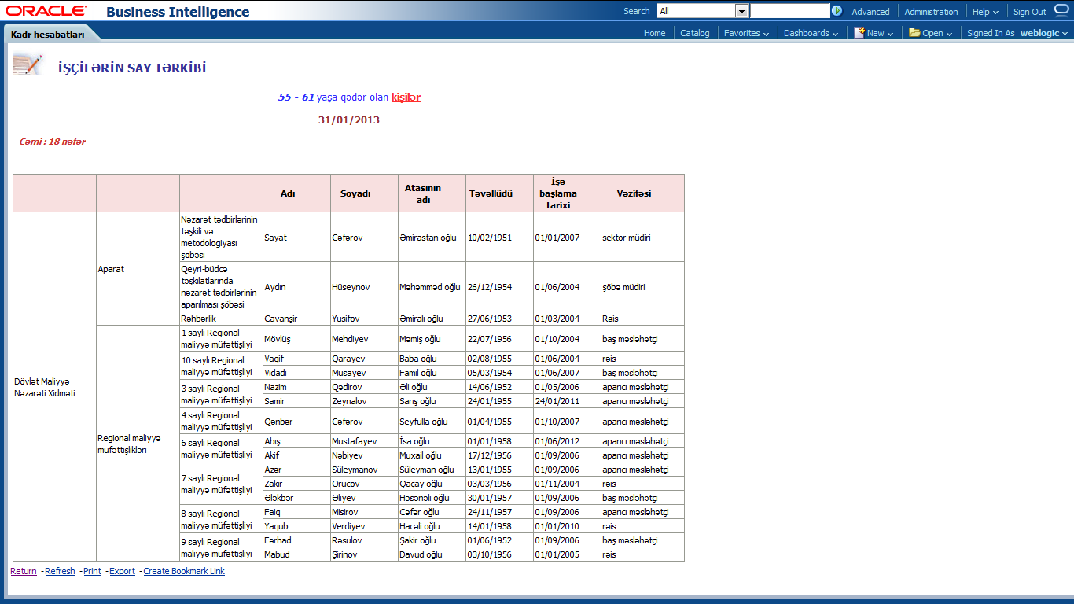
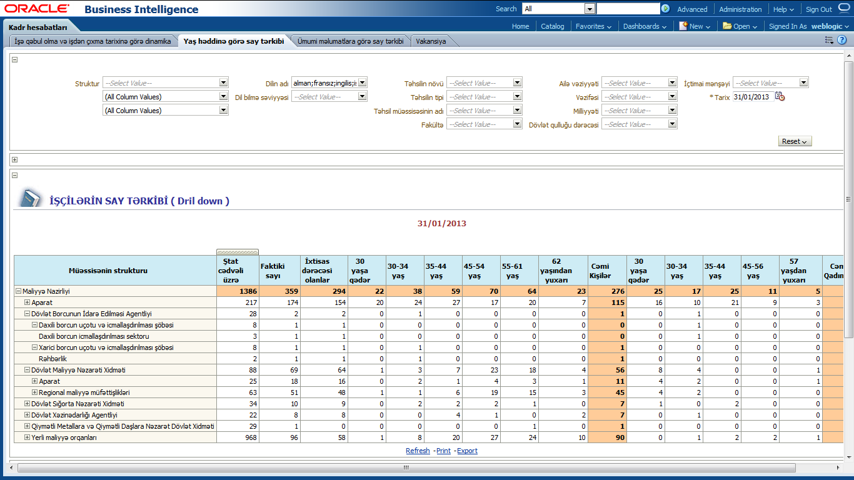
Reports generated by the system
Drill-down and audit results

Slide 43
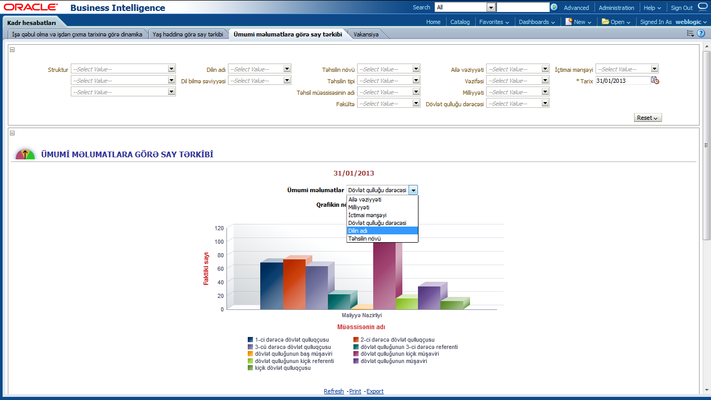
Reports generated by the system
Number of employees by the civil service rank

Slide 44
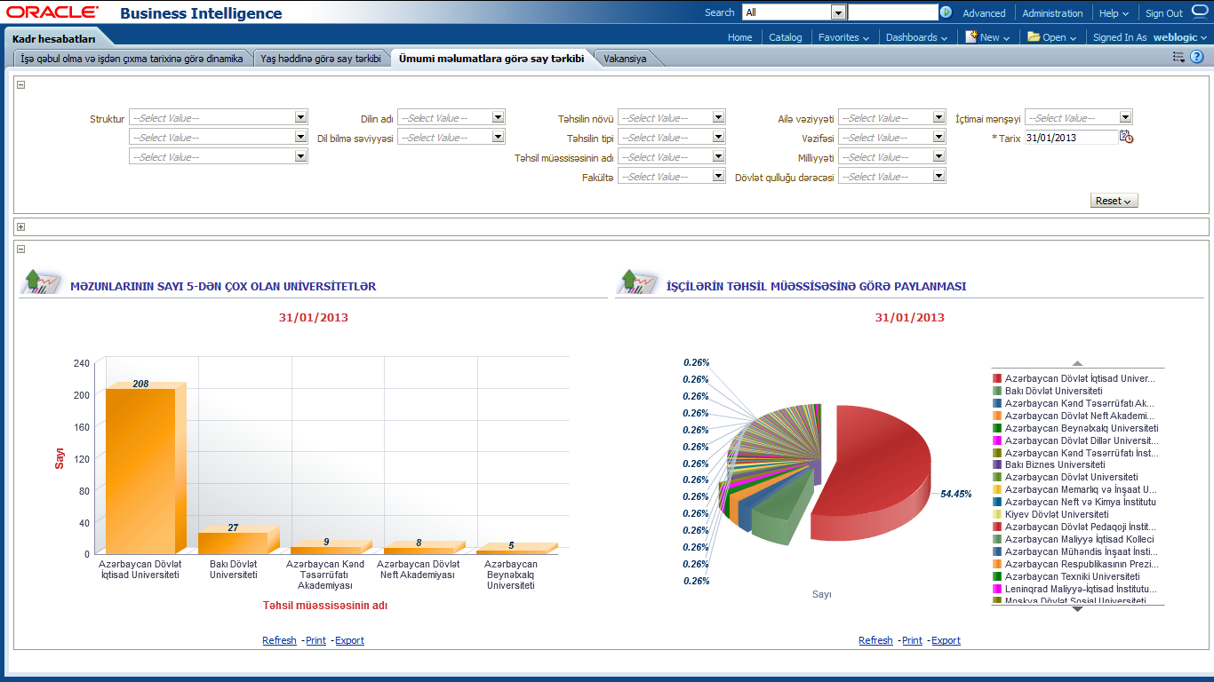
Reports generated by the system
Employees’ education institutions graduated from

Slide 45
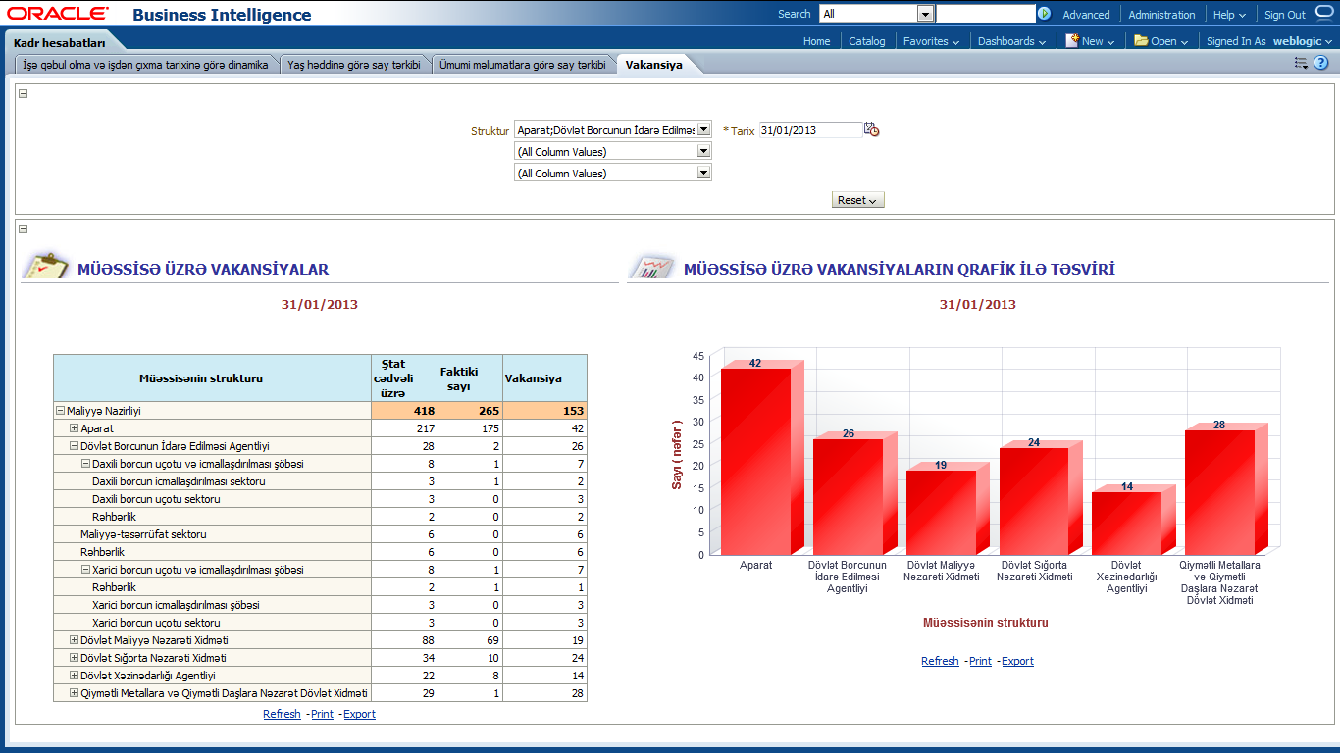
Reports generated by the system
Information on vacancies

Slide 46
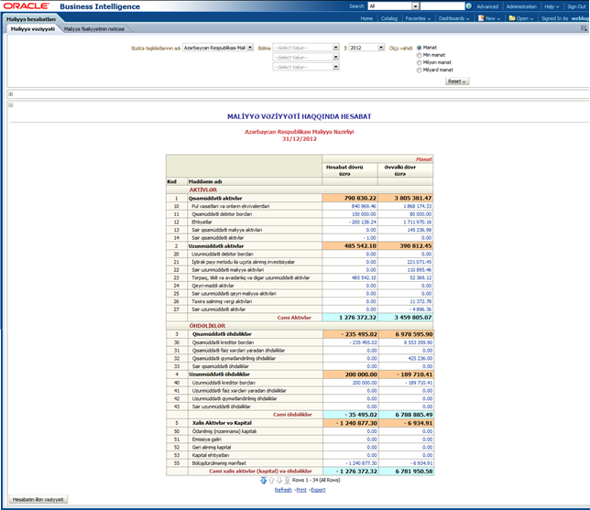
Reports generated by the system
Financial reporting in Oracle Business Intelligence

Slide 47
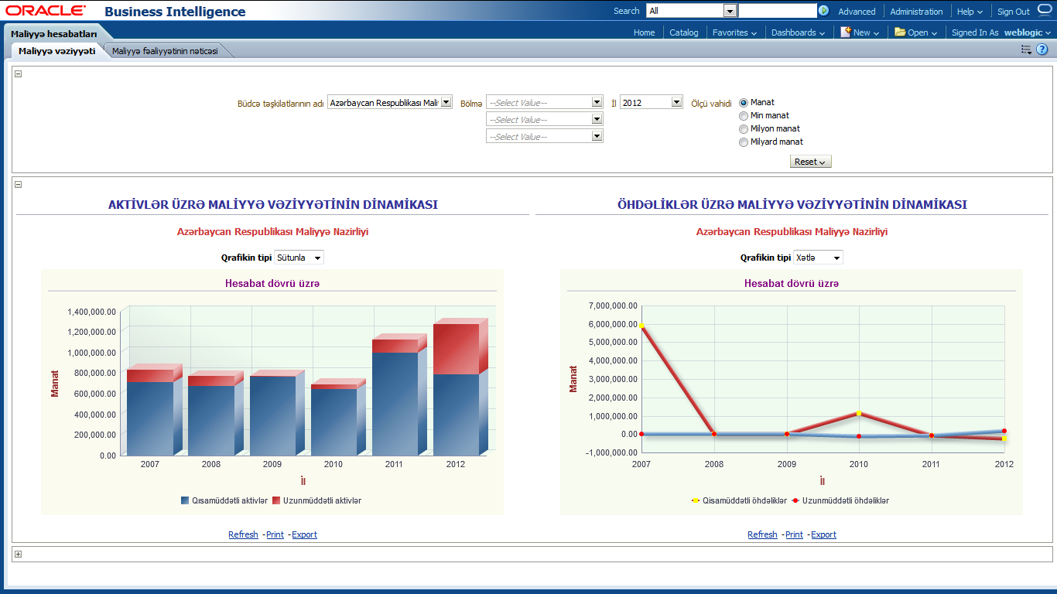
Reports generated by the system
Dynamics of financial position by assets and liabilities

Slide 48
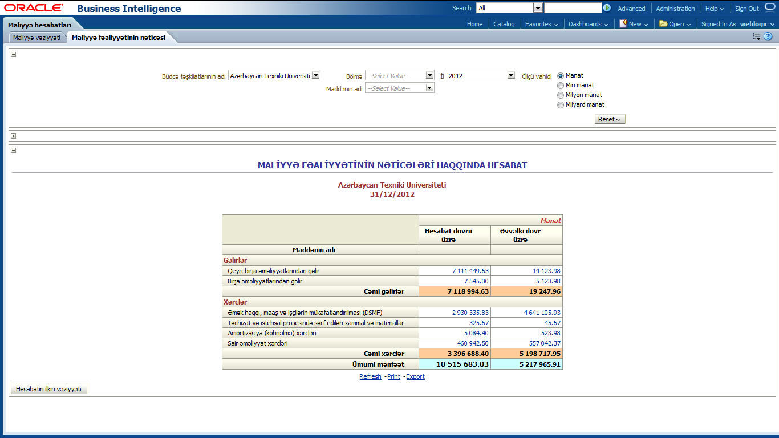
Reports generated by the system
Report on results of financial activity

Slide 49
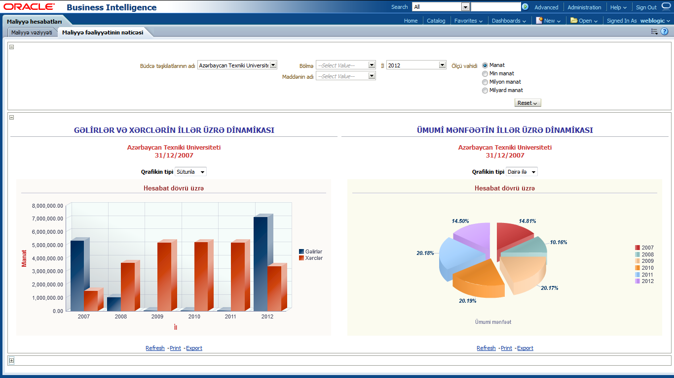
Reports generated by the system
Dynamics by years: revenue, losses and general profit

Slide 50
Thank you!
Ministry of Finance
Azerbaijan Republic
Azerbaijan, Baku city, B.Vahabzade str. 9
Tel: (994 12) 510 1100
Fax: (994 12) 439 2633
E-mail: office@sinam.net
URL: www.sinam.net

